Slide 1

Telecom Customer Churn Prediction Ashley Jiangyang Data Science intensive Capstone Project April 2020

Slide 2
The Problem
What’s Churn?
customer churn, also known as customer attraction or customer turnover, occurs when customers stop doing business with a company or stop using a company’s services.
Why Care?
Due to the direct effect on the revenues of the telecom industrial, companies are seeking to develop means to predict potential customer to churn.
Who Might Care?
AT&T, Verizon Communication, Spring…
Other industrial dealing with customers

Slide 3
Why Churn Analysis?
Objectives
Goals
Customer Retention
Profitability
Cross & Up Sell
Customer wallet Share
Predict Behavior
Satisfaction
Customer Segmentation
Social Media Reach
Social Media Strategy
Cost (Marketing, Sales, Operations)
Better Customer Services
Impact of Churn on Referrals
Churn
Product Launch & Feature Enhancements
Negative Sentiment

Slide 4
What factors affect the telecom customer churn?
Market Penetration
Quality
Customer Services
Price
Functionality
Convenience
Data Source
-Kaggle:
- Telco Customer Churn – Focused Customer Retention Programs

Slide 5
Data Information
Data acquired: Data Complied: 22 February, 2020
Number of records: 7,544
Number of features: 106
Data Cleaning
Dummy Recoding
Deal with Missingness
Convert to corresponding catogory
Final Data
Number of records: 6,583
Number of features: 80

Slide 6
Data Exploration
Customer Churn
Customer Demographics
Customer Account
Customer Services

Slide 7
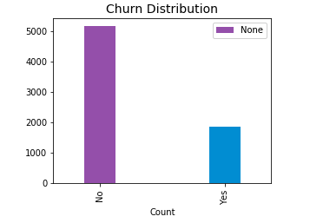
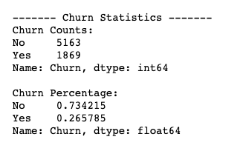
Customer Churn

Slide 8
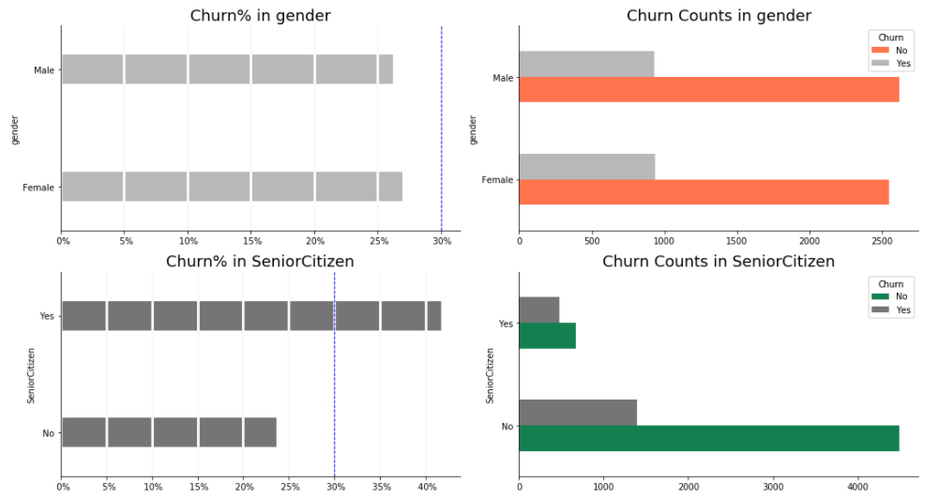
- Gender - Senior Citizen
Customer Demographics

Slide 9
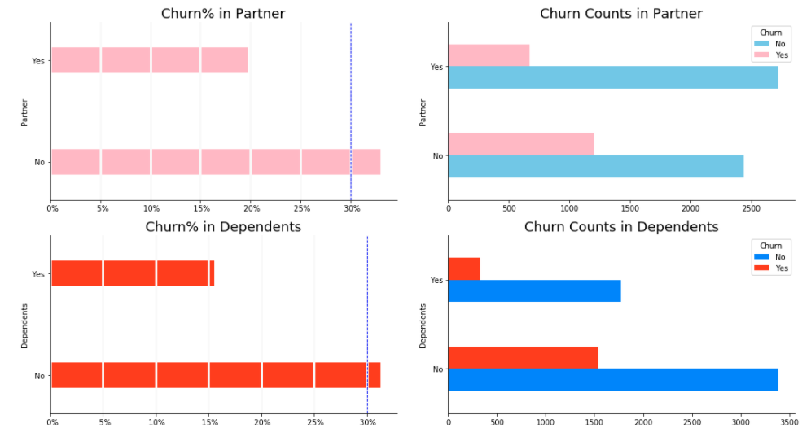
- Partner - Dependents
Customer Demographics

Slide 10
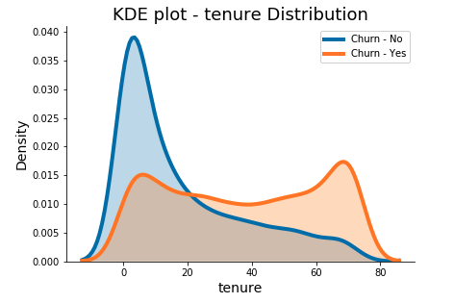
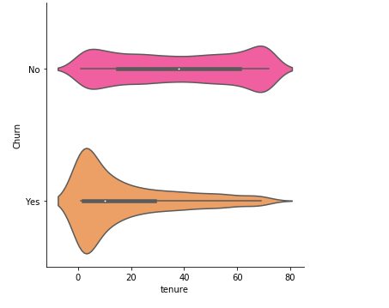
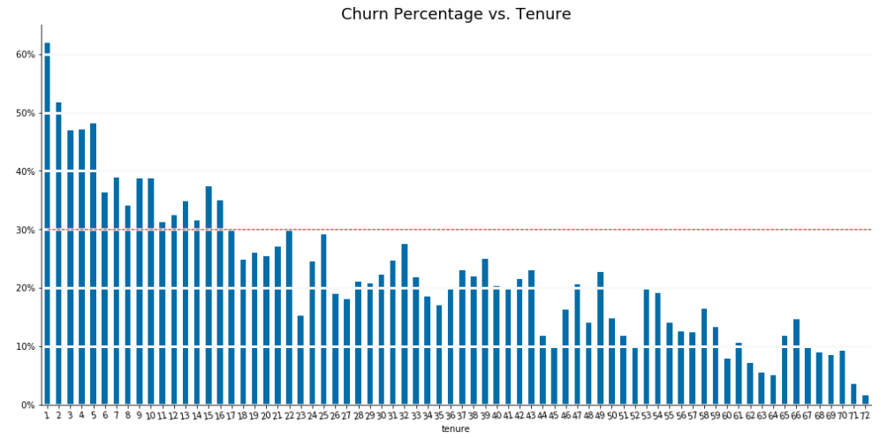
- Tenure
Customer Account

Slide 11
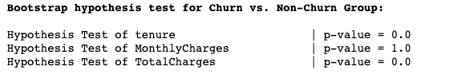
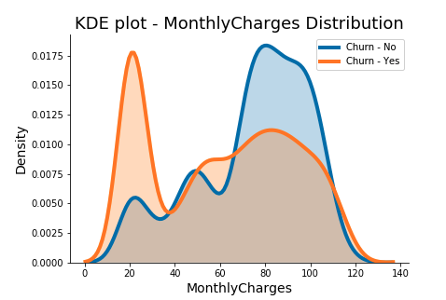
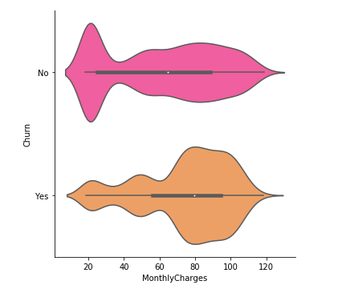
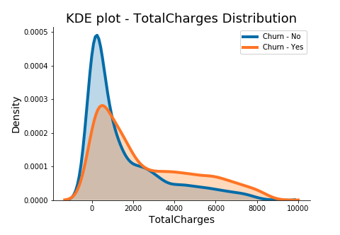
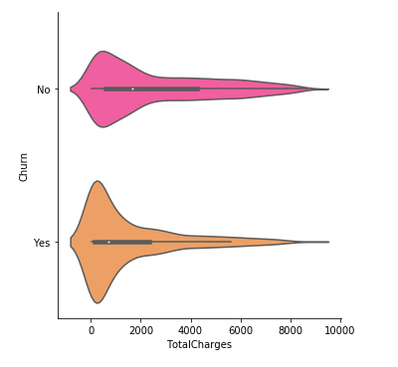
- Monthly Charge - Total Charge
Customer Account

Slide 12
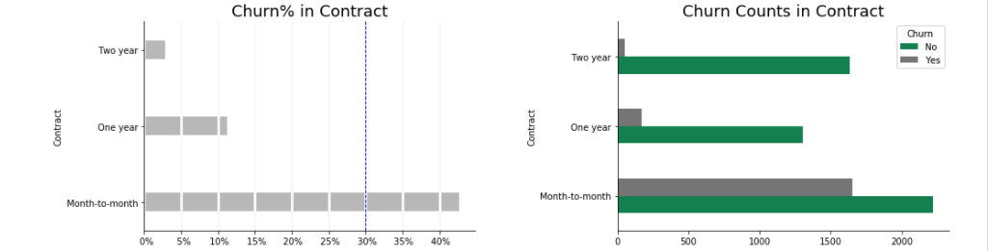
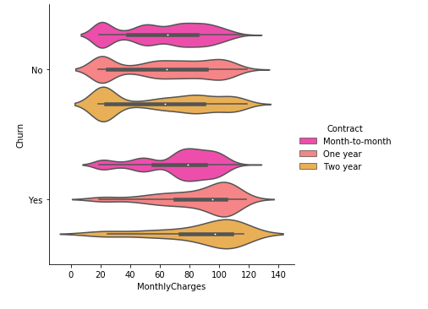
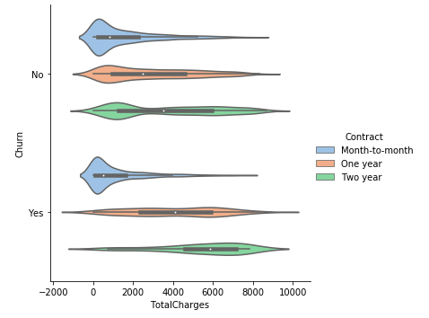
Customer Account
Contract

Slide 13
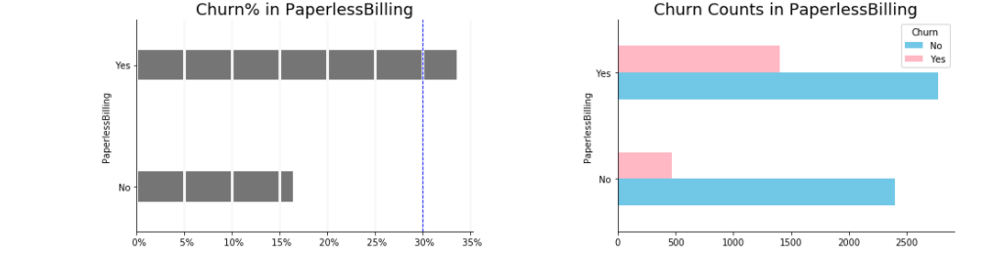
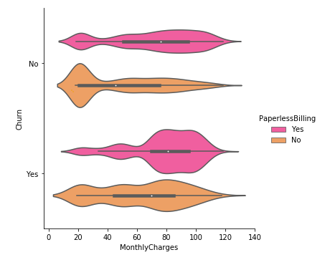
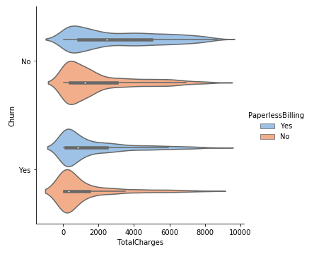
Customer Account
Paperless Billing

Slide 14
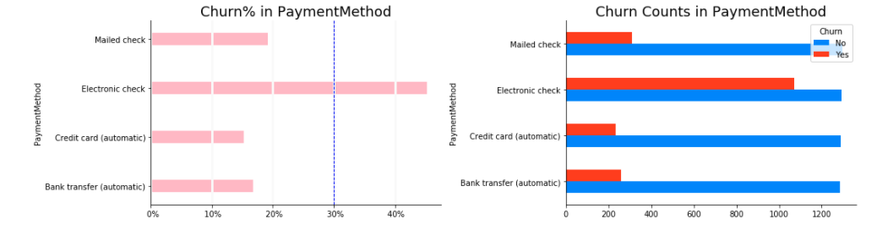
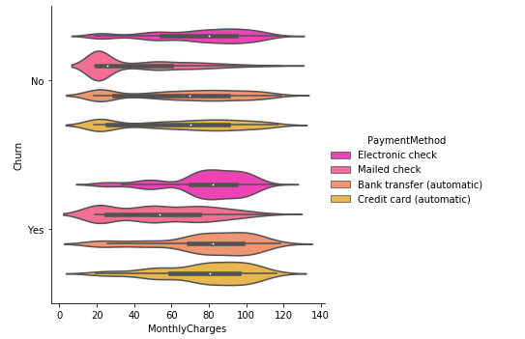
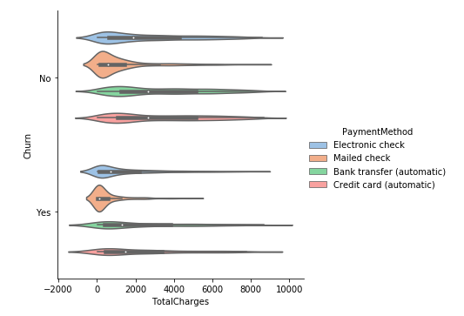
Customer Account
Payment method

Slide 15
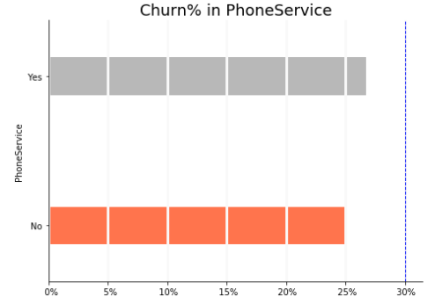
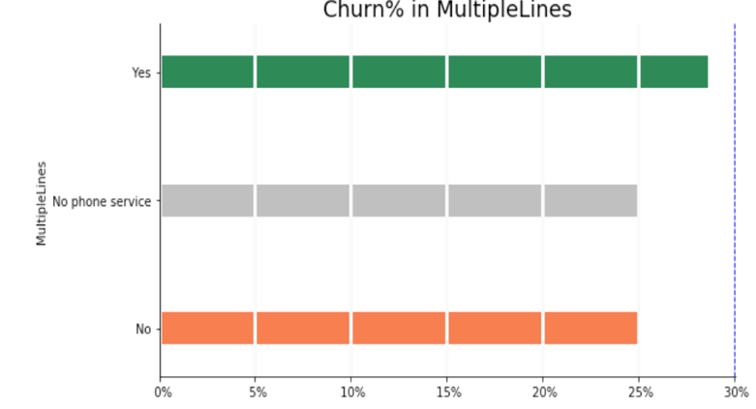
- Phone Services - Multiple Lines
Customer Services

Slide 16
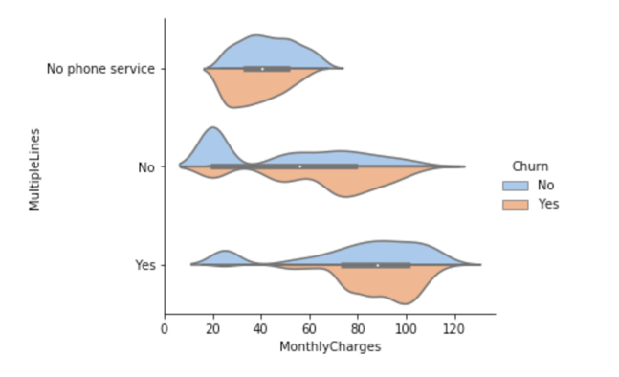
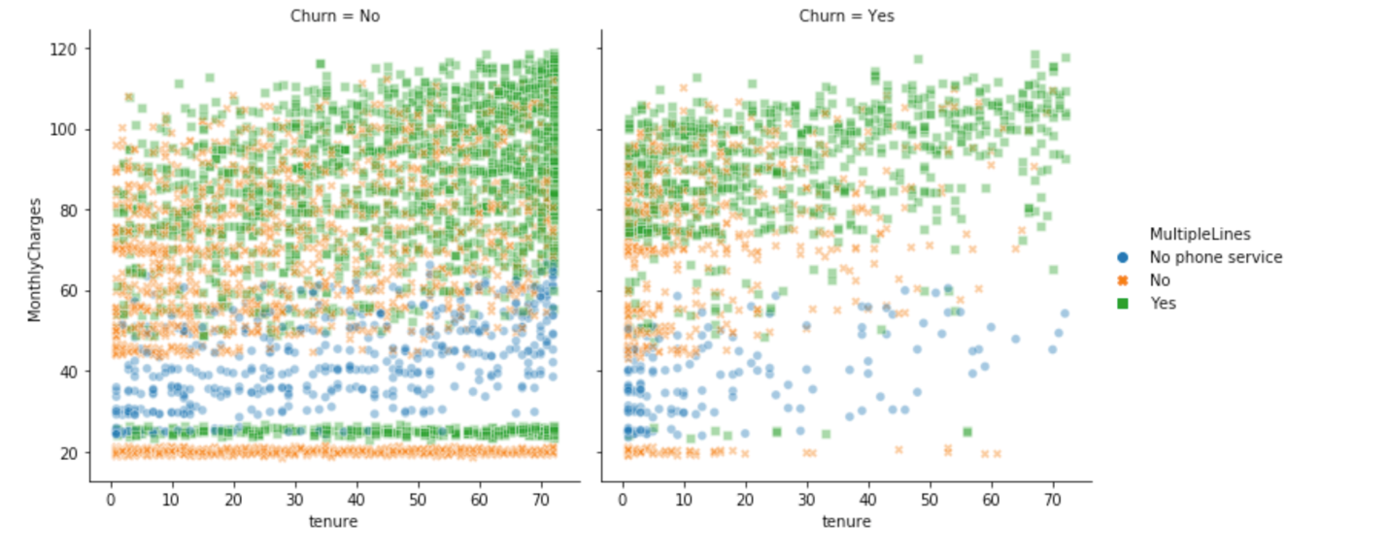
- Phone Services - Multiple Lines
Customer Services

Slide 17
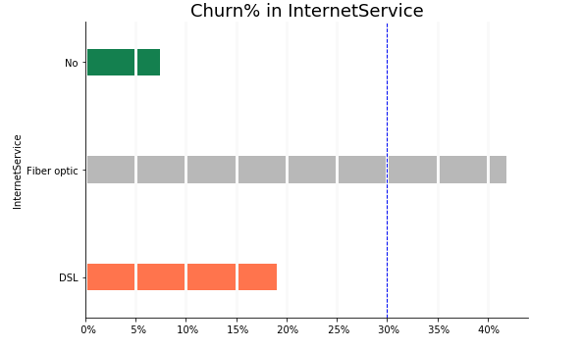
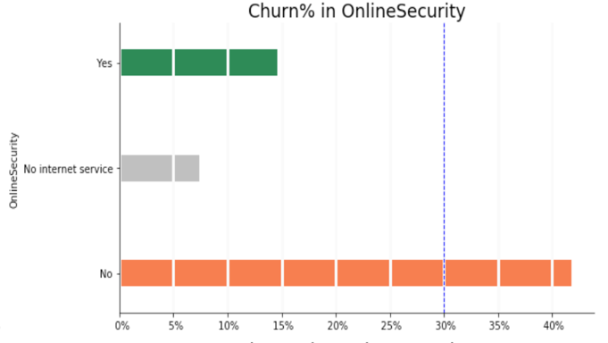
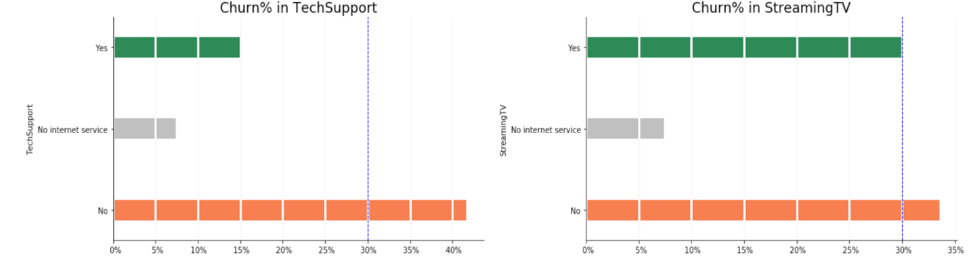
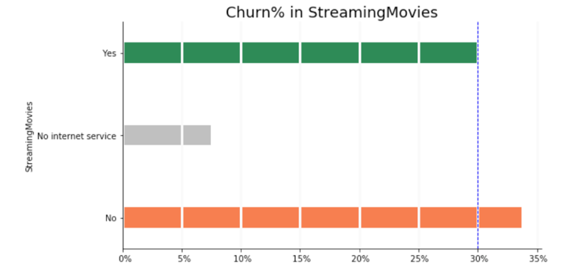
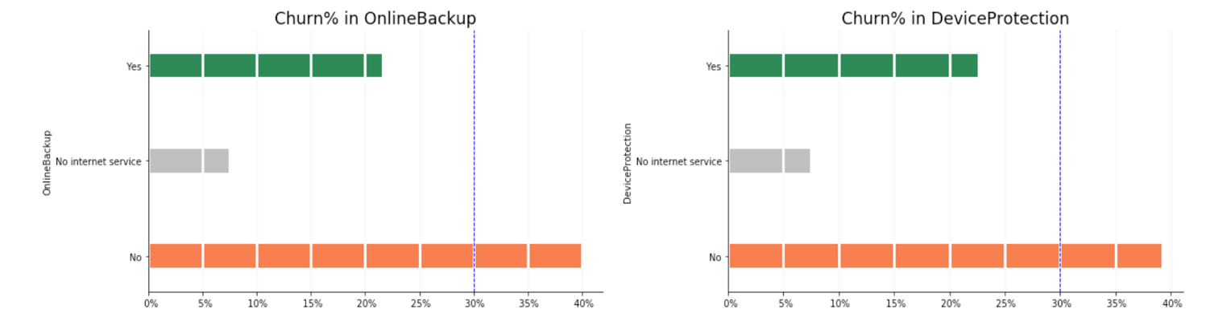
- Internet Services - online security - online backup - device protection - tech support - streaming TV - streaming movies
Customer Services

Slide 18
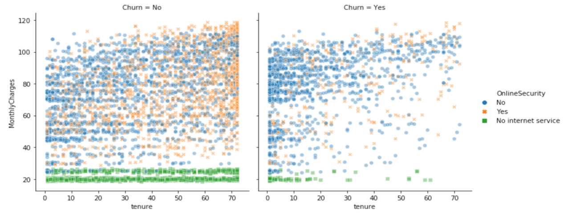
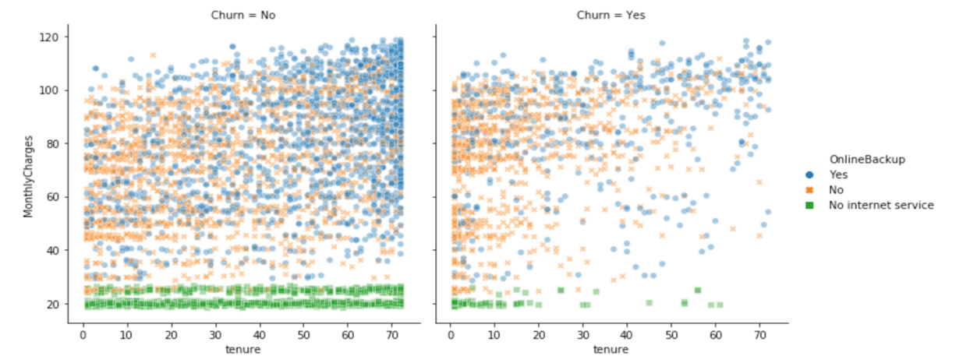
- Internet Services - online security - online backup - device protection - tech support - streaming TV - streaming movies
Customer Services

Slide 19
Survival Analysis
The total customer cohort retention
Cohort Analysis
Prediction for individual customers by Cox Proportional Hazard Model

Slide 20
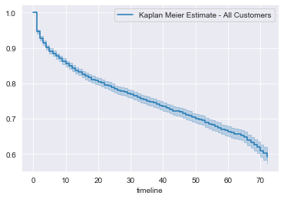
The total customer cohort retention

Slide 21
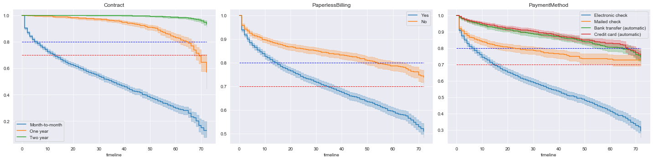
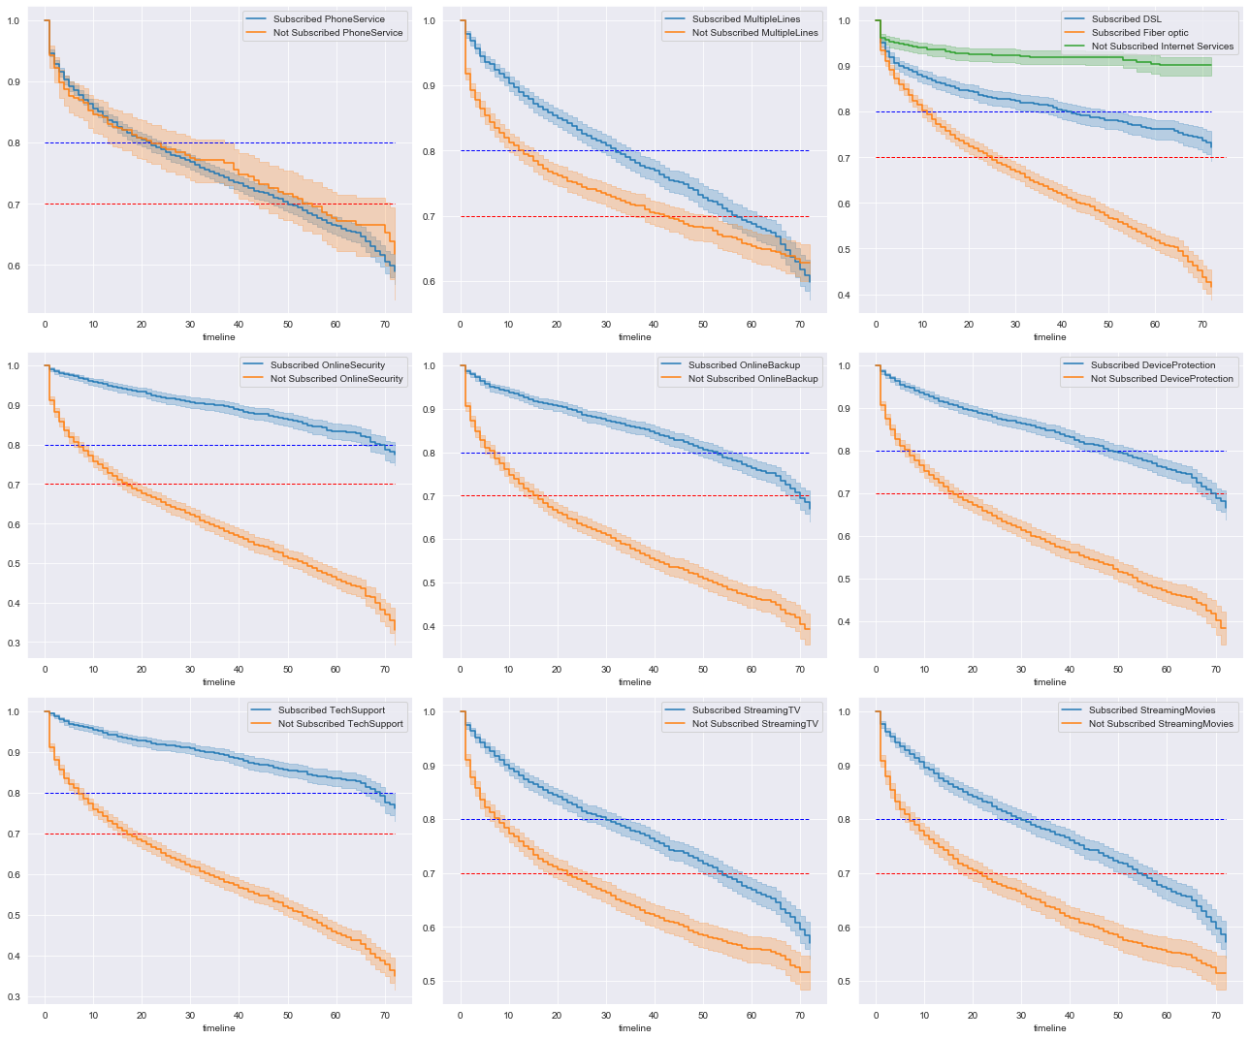
Cohort Analysis

Slide 22
Cohort Analysis

Slide 23
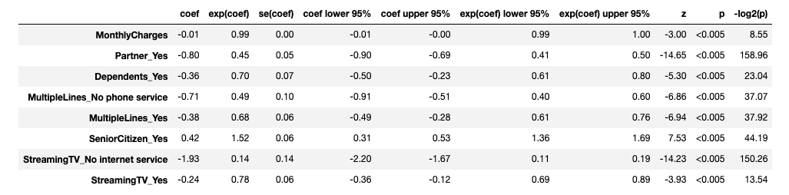
Prediction for individual customers by Cox Proportional Hazard Model
Churn ~ Monthly Charge + Partner + Dependents + multiple lines + Senior Citizen + Stream TV

Slide 24
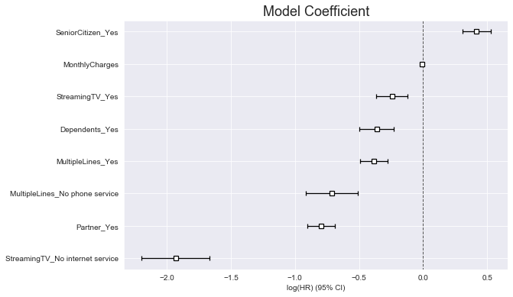
Prediction for individual customers by Cox Proportional Hazard Model
Churn ~ Monthly Charge + Partner + Dependents + multiple lines + Senior Citizen + Stream TV

Slide 25
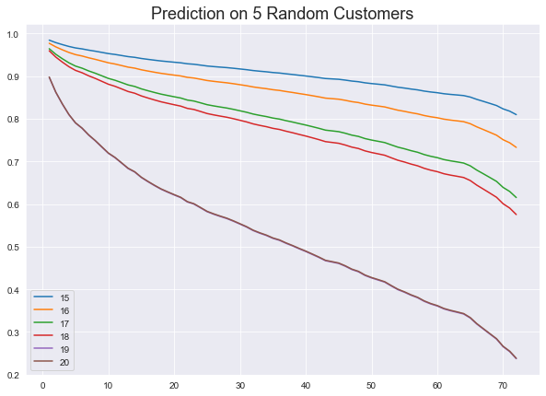
Prediction for individual customers by Cox Proportional Hazard Model
Churn ~ Monthly Charge + Partner + Dependents + multiple lines + Senior Citizen + Stream TV

Slide 26
Modeling
Data Preprocessing
Model Pipeline
Logistic Regression
Gaussian Naïve Bayes
Random Forest
XGBoost
Model Comparison

Slide 27
Modeling
Data Preprocessing
- Dummy encoding
- Data Splitting
- Resampling or Weighting
- Scaling

Slide 28
Modeling
Model Pipeline
- Resampling
- Model fitting
- Scaling

Slide 29
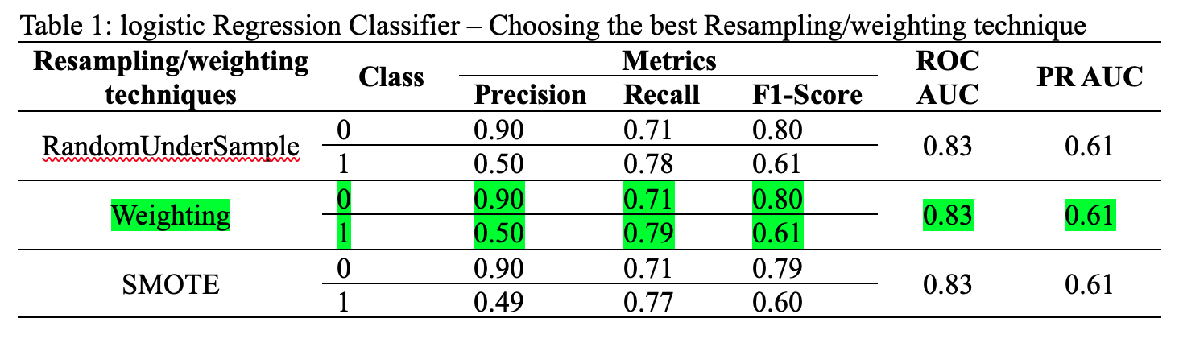
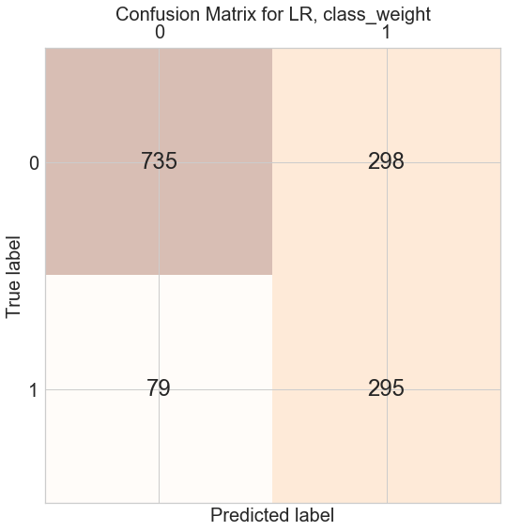
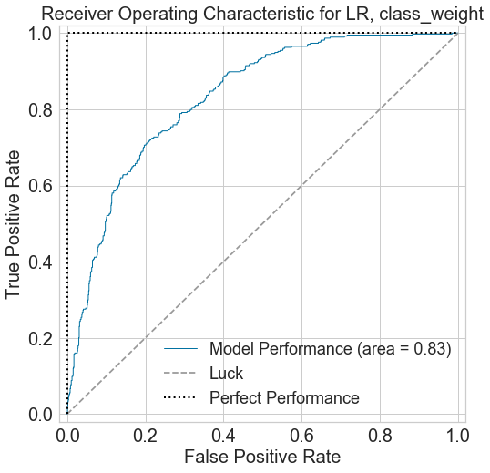
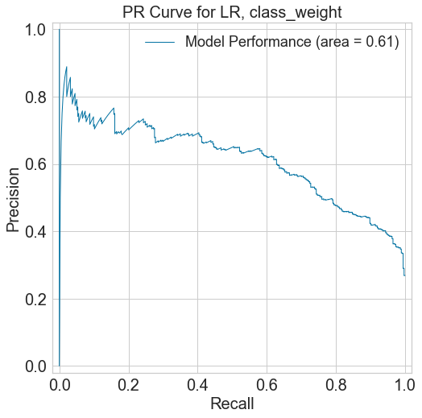
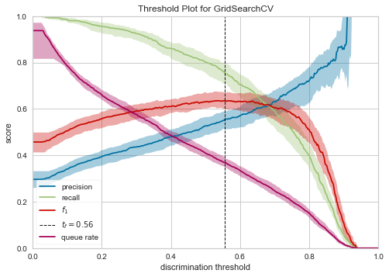
Modeling
Logistic Regression

Slide 30
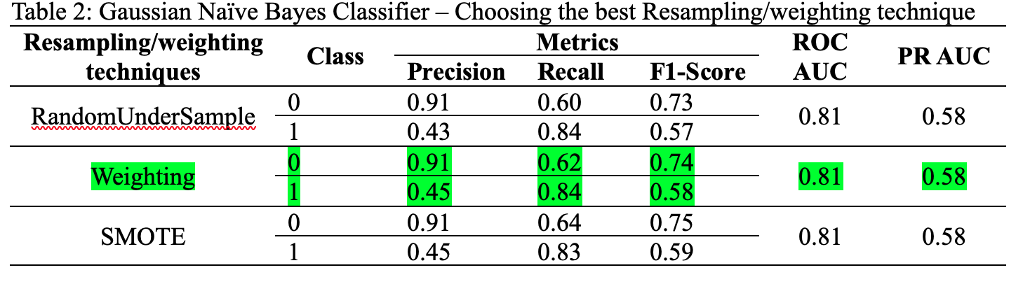
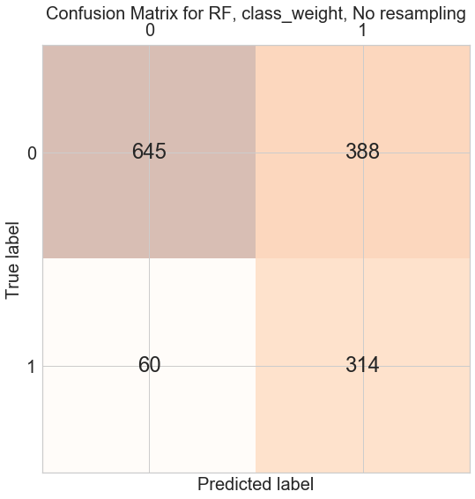
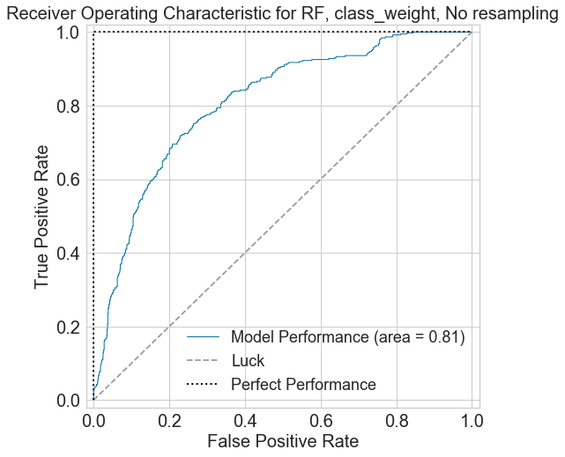
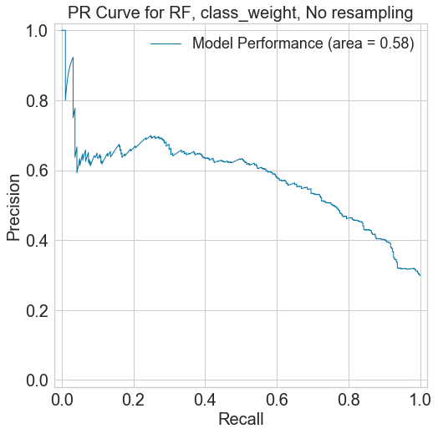
Modeling
Gaussian Naïve Bayes

Slide 31
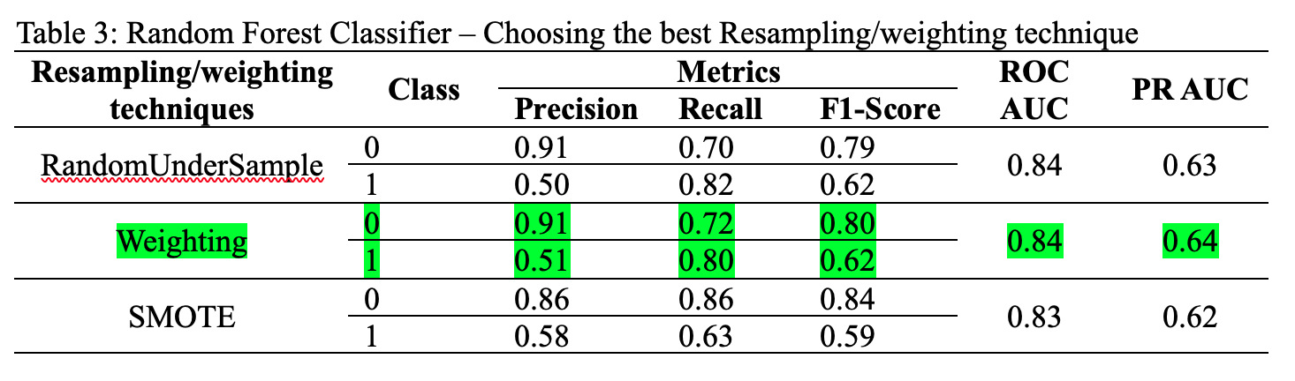
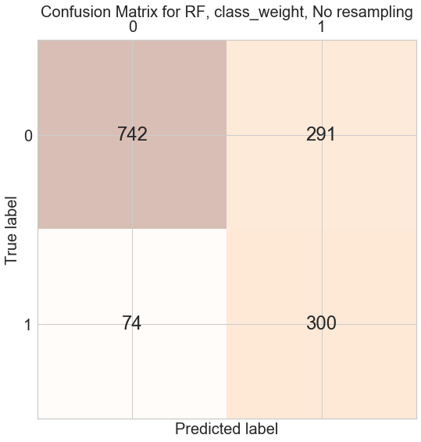
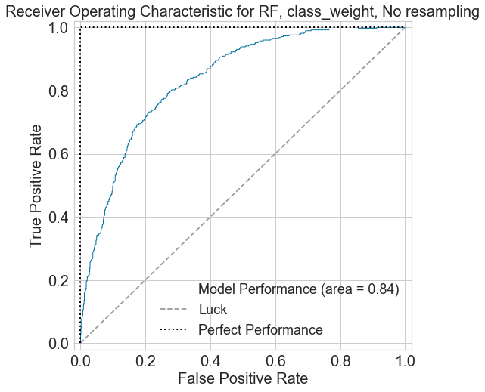


Modeling
Random Forest

Slide 32





Modeling
XGBoost

Slide 33


Modeling
Model Comparison

Slide 34
Conclusion
All of the features contributed to the predictive power of the model.
Out of 4 supervised machine learning models, the XGboost provided the best results.
Over three sampling method – random undersampling, class weight and SMOTE, the class weight have the best performance, though the three sampling methods have a similar contribution.
All the data are applied with minmax scaler.
5-fold cross validation and parameter tuning are combined to get the best parameters.
The separation between churn and non-churn still needs to be improved.
With more ideas, the model can be improved in the features.

